Slide 1
The Opdc Missense Mutation of Pax2 Has a Milder Than Loss-of Function Phenotype
Sally H. Cross, Lisa McKie, Katrine West, Emma Coghill, Jack Favor, Shoumo Bhattacharya, Steve Brown and Ian Jackson
Human Molecular Genetics, 2011, Vol. 20, No. 2 Pages 223-234
Yvonne Gicheru

Slide 2
Outline
Background : Pax2 and associated defects
Objectives : characterization of Optic disc Coloboma (Opdc) mutation
Experimental methods and results
Conclusion
Future research/Critique

Slide 3
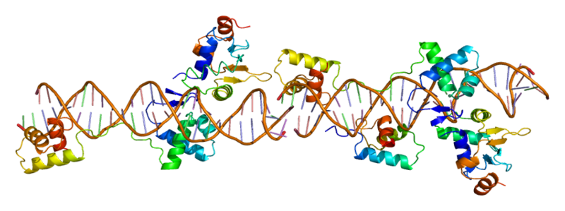
Pax2 (Paired Box 2)
Member of PAX family of transcription factors (9)
Conserved DNA-binding paired box domain, 11 exons, 417aa
2 structurally independent subdomains each with 3 α-helices
Notes:
Pax2 is human homologue of Drosophila’s prd gene
Pax6 is considered a master control gene for eyes and sensory organs and neural and epidermal tissues
Transcription factors recognize and bind to promoter regions helping the RNA poly to know where to bind. (TATA, GC, CAAT boxes)
Pax2 binds to target promoters which allows transcription of embryologically crucial genes

Slide 4
Pax2 roles and mutation effects
Critical roles in eye, CNS and urogenital development. Possible role in kidney development
Mutations are usually loss of function mutations
Defects in heterozygotes include:
1. renal hypoplasia
2. optic disc colobomas
4. cerebellar malformation
5. inner ear defects
6. significant degree of lethality
Homozygotes die from renal agenesis

Slide 5
Opdc Missense Mutation
Induced point mutation with ENU
Missense mutation- I40T ( T-to-C transition)
Located in first helix(arrow) of exon 2
Notes:
- Schematic diagram of pax2 paired domain

Slide 6
Steps in characterization
PCR
amplification and sequencing of Pax2 exons in parental and Opdc mutants in C57 and C3H
Crossing
Crossing Opdc to C57 and C3H
Phenotype
Crossing Pax2 Opdc/+, recovery and analysis of offspring recovered
Mutation effect on kidneys examined

Slide 7
Steps in characterization
Binding
Pax2 Opdc/+ binding properties on different DNA sites using bandshift analysis
Activation
NIH3 cells transfected with CMV-Pax2a/b with Opdc mutation
Transcript
Transcription levels of pax2 target genes analyzed by RT-PCR
co-transfection with Pax2 targets upstream of luciferase reporter
Notes:
- Recombinant proteins produced in E.coli
- CMV promoter drives stable constitutive expression and the plasmid vector has a flag that allows detection and purification of the protein

Slide 8
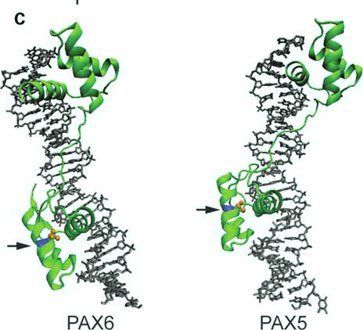
Identification of mutation
Arrow points to Ile in 1st helix and doesn’t interact with DNA binding site

Slide 9
Experiments and results
Identify position and type of mutation
- missense mutation, I40T
Cross Opdc mutant into C57BL/6J and C3H

Slide 10
Crossing Opdc mice with WT
Table 1.
Mice or embryos wild-type, homozygous or heterozygous for the
Opdc mutation on two genetic backgrounds
Background strain | Stage | Cross | ++ | Pax2^{Opdc/+} | Pax2^{Opdc/Opdc} | P-valueª
C57BL/6J | Weaning | Pax2^{Opdc/+} × wild-type | 137 | 88 | N/A | <0.01
C3H | Weaning | Pax2^{Opdc/+} × wild-type | 131 | 123 | N/A | >0.5
C57BL/6J | Embryo, E15.5 to E18.5 | Pax2^{Opdc/+} × Pax2^{Opdc/+} | 30 | 63 | 26 | >0.5
C3H | Embryo, E15.5 to E17.5 | Pax2^{Opdc/+} × Pax2^{Opdc/+} | 32 | 49 | 28 | >0.1

Slide 11
Crossing Opdc mice with WT
Table 2.
Kidney mass as fraction of total embryo mass of E18.5 embryos wild-type or
heterozygous for the Opdc mutation in two strains
Background strain | Genotype | Left kidney, % of total embryo mass (N) | Right kidney, % of total embryo mass (N) | Significance left versus rightª
C57BL/6J | Wild-type | 0.57 (15) | 0.52 (15) | P = 0.203
C57BL/6J | Heterozygous | 0.39 (21) | 0.38 (21) | P = 0.817
Significance wild-type versus heterozygousª |  | P = 0.000337 | P = 0.007908
C3H | Wild-type | 0.42 (11) | 0.40 (11) | P = 0.790
C3H | Heterozygous | 0.42 (10) | 0.35 (10) | P = 0.097
Significance wild-type versus heterozygousª |  | P = 0.970894 | P = 0.381662

Slide 12
Crossing Opdc mice with WT
Table 3.
Glomeruli counts in wild-type and heterozygous mice in C57BL/6J
(at E18.5) and in C3H
Background strain | Genotype | Average glomerulus count | Significanceª
C57BL/6J | WT | 13.33
C57BL/6J | WT | 11
C57BL/6J | WT | 11.66
C57BL/6J | Het | 10.66
C57BL/6J | Het | 9
C57BL/6J | Het | 8.33 | P = 0.065
C3H | WT | 17
C3H | WT | 12.5
C3H | WT | 21.5
C3H | WT | 19.5
C3H | Het | 15
C3H | Het | 13.5
C3H | Het | 21 | P = 0.4

Slide 13
Experiments and results
Identify position and type of mutation
Cross Opdc mutant into C57BL/6J and C3H
- C57 background has more defects compared to the C3H
Crossing heterozygous mutants and analyzing offspring

Slide 14
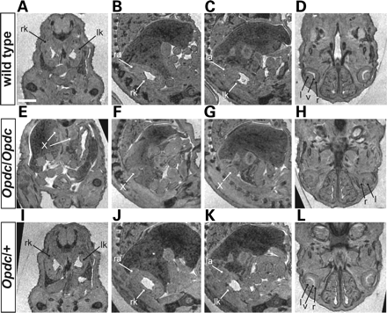
Notes:
Figure 2. Opdc causes renal agenesis and developmental retardation of eyes. MRI of the kidneys and eyes of E15.5 embryos. (A–C) Transverse and sagittal sections showing the left and right kidneys (lk and rk) and left and right adrenals (la and ra) in a wild-type embryo. (D) Transverse section showing the eye structures including lens (l), vitreous (v) and retina (r) in a wild-type embryo. (E–H) Corresponding sections through a Pax2^{Opdc/Opdc} embryo, showing that the kidneys are absent. The bilateral structure ‘X’ may be an adrenal. The eyes are poorly developed, with the vitreous not clearly seen in any section. (I–L) Corresponding sections through a Pax2^{Opdc/+} embryo which looks normal. Scale bar = 50 U (1250 µm).

Slide 15
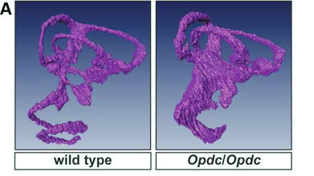
Phenotype- crossing Pax2 Opdc/+ Semicircular canals

Slide 16
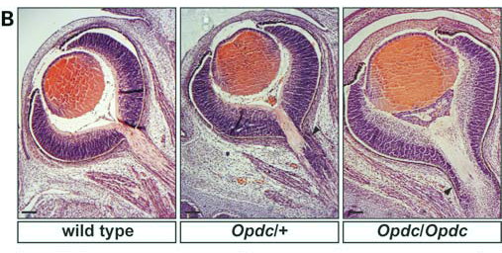
Phenotype- crossing Pax2 Opdc/+ optic disc

Slide 17
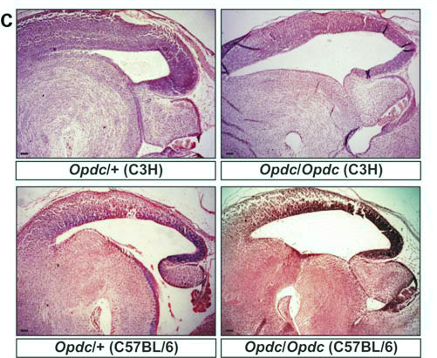
Phenotype- crossing Pax2 Opdc/+ cerebellum formation

Slide 18
Experiments and results
Identify position and type of mutation
Cross Opdc mutant into C57BL/6J and C3H
Crossing Opdc heterozygous mutants and analyzing offspring
- renal agenesis, inner ear malformation and optic disc defect in homozygous Opdc mutants
- no effect of mutation on kidney development in heterozygote
- slight optic disc defect on heterozygote
- No effect of mutation on cerebellar formation
DNA binding properties using bandshift analysis

Slide 19
DNA binding properties Pax2Con and e5
Pax2Con- high affinity binding sequence
e5 – less favorable binding sequence
Notes:
Used regular non denaturing polyacrylamide gels
E5- target site of drosophila prd gene

Slide 20
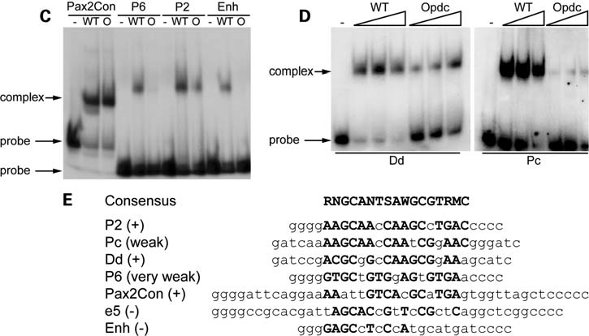
DNA binding properties
E- pax2 binding sequences

Slide 21
Experiments and results
Identify position and type of mutation
Cross Opdc mutant into C57BL/6J and C3H
Crossing Opdc heterozygous mutants and analyzing offspring
DNA binding properties using bandshift analysis
- Opdc binds to some target sequences and this less strongly than the WT
Transactivation of luciferase reporter gene under Pax2 target sequence using CMV constructs transfected into NIH3 fibroblast cells

Slide 22
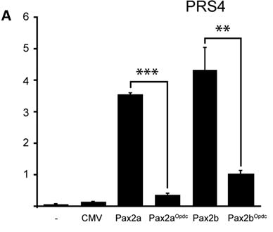
Transactivation of reporter gene with PRS4

Slide 23
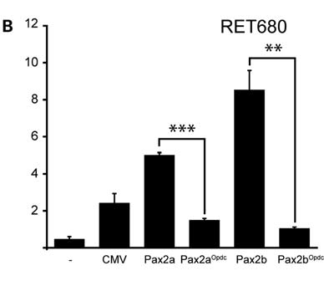
Transactivation of reporter gene with RET680

Slide 24
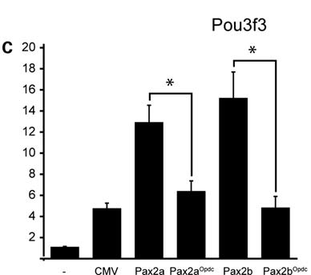
Transactivation of reporter gene with Pou3f3

Slide 25
Experiments and results
Identify position and type of mutation
Cross Opdc mutant into C57BL/6J and C3H
Crossing Opdc heterozygous mutants and analyzing offspring
DNA binding properties using bandshift analysis
Transactivation of luciferase reporter gene under Pax2 target sequence using CMV constructs transfected into NIH3 fibroblast cells
- Opdc shows considerably less transactivation compared to WT
Measuring transcription of downstream genes

Slide 26
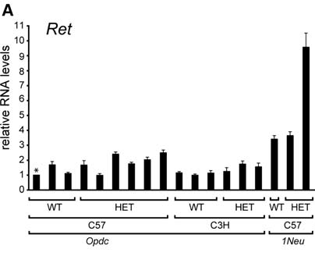
Transcription levels of Wt1

Slide 27
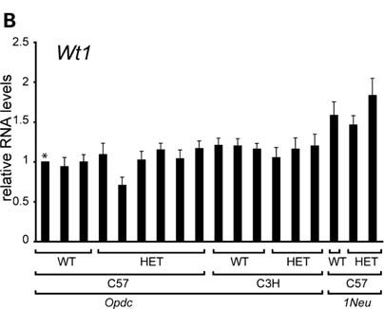
Transcription levels of Ret

Slide 28
Experiments and results
Identify position and type of mutation
Cross Opdc mutant into C57BL/6J and C3H
Crossing Opdc heterozygous mutants and analyzing offspring
DNA binding properties using bandshift analysis
Transactivation of luciferase reporter gene under Pax2 target sequence using CMV constructs transfected into NIH3 fibroblast cells
Measuring transcription of downstream genes
- No sig difference between WT and mutant in transcript levels of target genes

Slide 29
Conclusion
Milder than loss of function phenotypes were observed in the Opdc mutation
The mutant Pax2 protein is still able to bind target DNA and transactivate reporter genes but with reduced efficiency
Genetic background effects cause different phenotypes in mice and humans- modifier genes which affect penetrance, dominance and expressivity
Pax2 could be a candidate gene for colobomas without renal defects

Slide 30
Future Research
Identification of modifier genes would help shed light on why there are differences in phenotypes in different strains- their mechanisms would also be informative, gene targeting…
Pax2 and Pax6 interact warranting a screening of patients with coloboma defects but no Pax2 mutations
Pax2 may be a good candidate gene for screening patients with coloboma defects alone- results in this paper showed a pax2 mutation without apparent renal defects

Slide 31
Critique
Loss of function mutation images would have been useful for comparison with Opdc mutants-instead of simply mentioning that there are similarities
Activation by CMV construct alone was not addressed though mentioned and considered
Relative RNA increase with a loss of function mutation seemed relatively high and counter to previous results Fig 5B and 6A- no explanation given for counter results
Units for glomeruli count not provided

Slide 32
Questions?

